Slide 1
To replace with my own drawing

Slide 2
CSS143 Computer Programming (II)

Slide 3

Source Control: Branch
Commit 1
Commit 2
Commit 3
Commit 6
Merge, Commit 7
Master branch
another branch
Commit 4
Commit 5

Slide 4




Push
Pull

Slide 5
Pull
Push

Slide 6
Next Lecture
Code-Along
Goals:
Brush up Java
Understand Git commits & branches
Know how to fork, clone, pull and push from Github

Slide 7

Exercise 1:
Write code to find the max number in an integer array
Return the index of the max number
Demonstrate code works correctly
12
12
1
7
18
10
3
0
1
2
3
4
5
6

Slide 8
Java Basics
Input: An array of Integers
12
12
1
7
18
10
3
0
1
2
3
4
5
6
-9
-2
-1
-7
0
1
2
3

Slide 9
Java Basics
Input: An array of Integers
12
12
1
7
15
15
3
0
1
2
3
4
5
6
Empty array
return -1
null array
return -1

Slide 10
Setup
Create inputs, expected outputs, etc.
Action
Feed inputs to the function being tested
Verify
Compare actual outputs with expected outputs

Slide 11
Let’s start with these tests
Get starter code from here:
https://github.com/pdgetrf/code-along-max-number

Slide 12
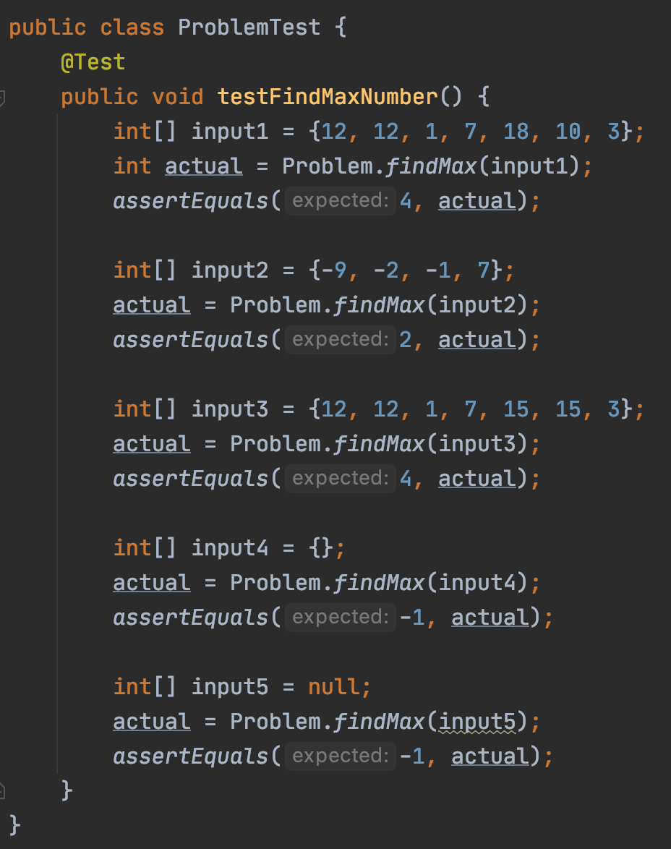
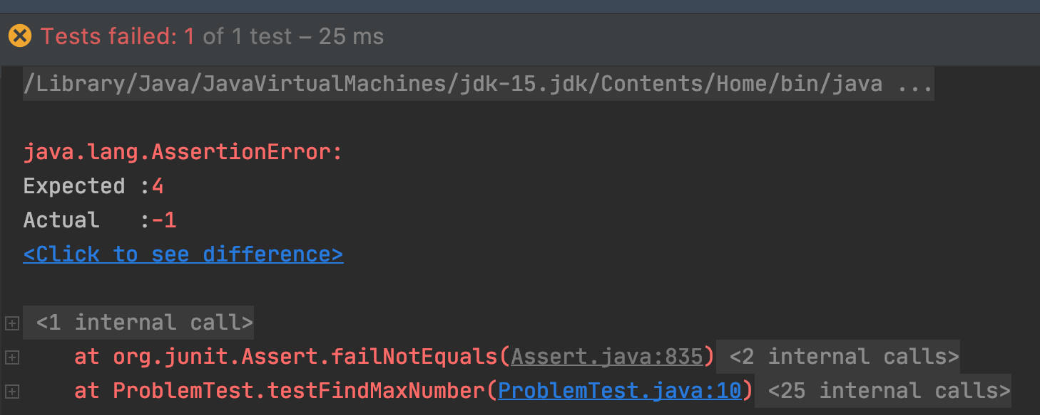
Test Failing

Slide 13
int maxIdx = 0;
values
12
12
1
7
18
10
3
int values[]={12, 12, 1, 7, 18, 10, 3}
0
1
2
3
4
5
6

Slide 14
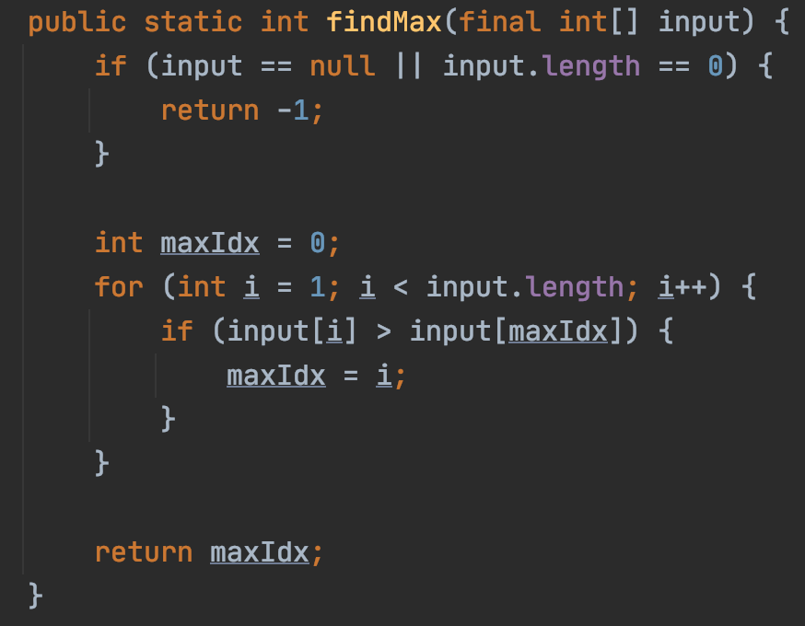
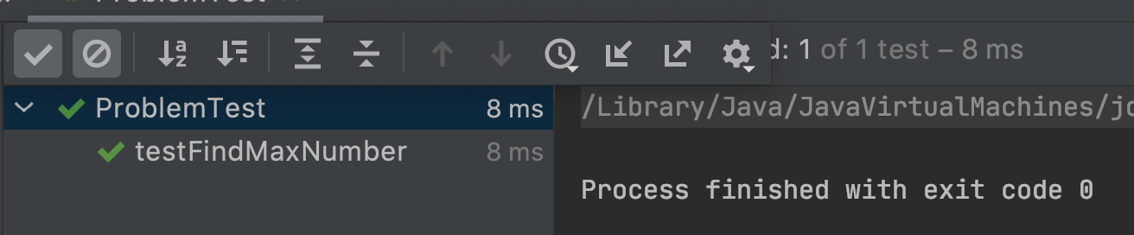
Test Passed

Slide 15
Any improvement?
Refactor

Slide 16
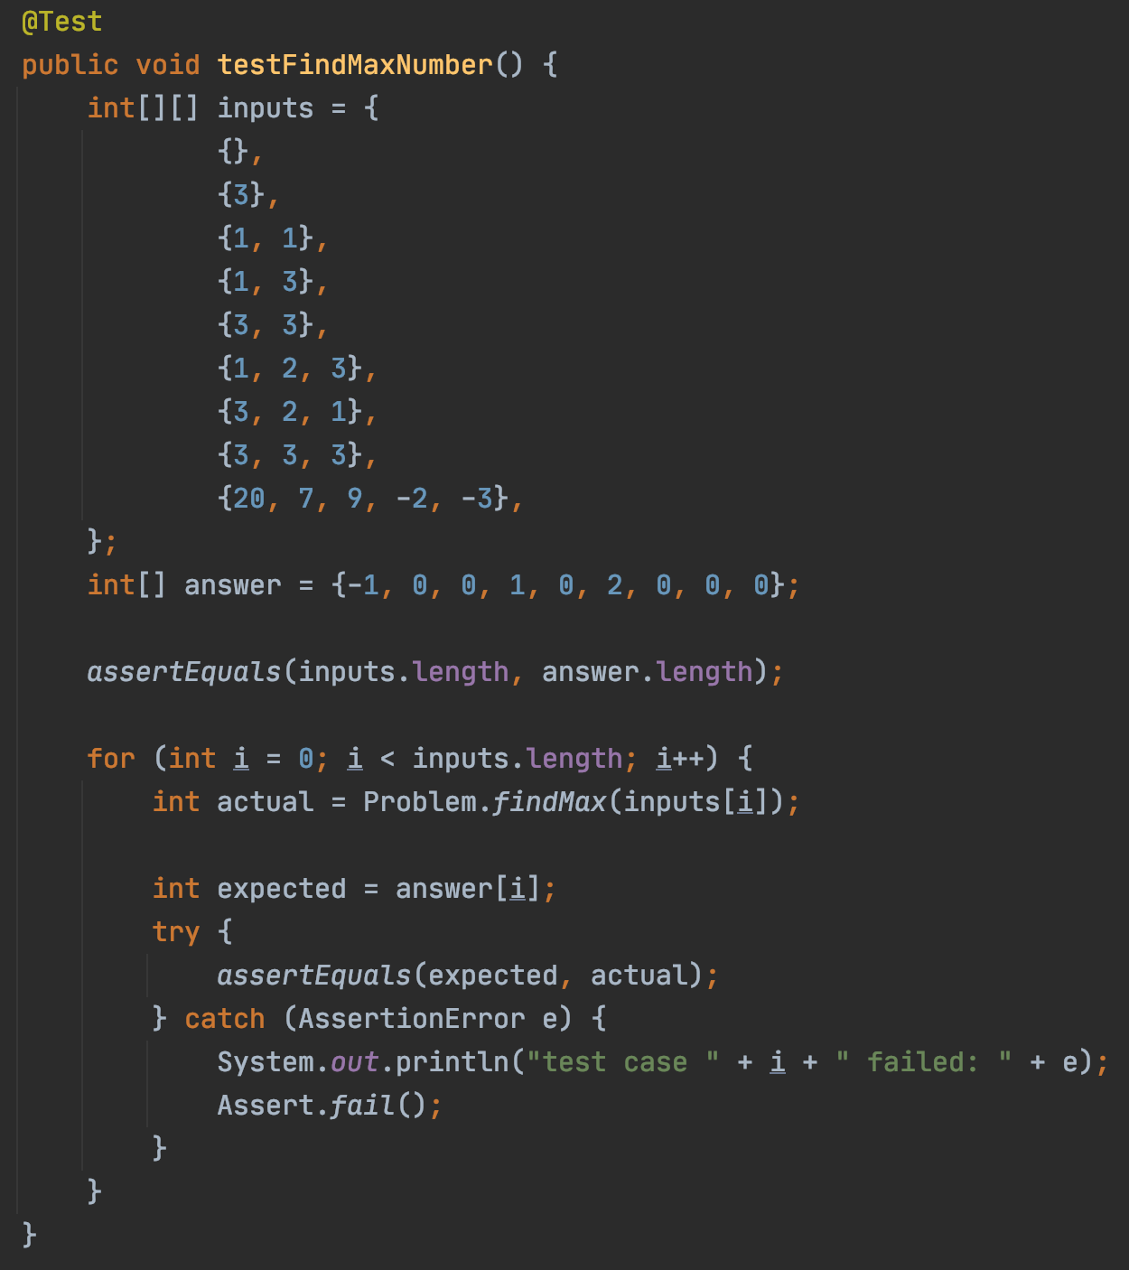

Slide 17
Refactor
Don’t Repeat Yourself

Slide 18


“Don’t Repeat Yourself”

Slide 19
Coding Procedures
First, write Tests
Test should fail
Then, implement Feature
Test should pass
And then, refactor
Test should still Pass

Slide 20


Write code to find the max number in an integer array
12
12
1
7
18
10
3
99
-2
13
0
1
2
3
4
5
6
7
8
9
How many comparisons?
Best case:
$$N$$
Worse case:
$$N$$
Can we do better?

Slide 21
Data Structure
Algorithm
https://en.wikipedia.org/wiki/Heap_(data_structure)

Slide 22
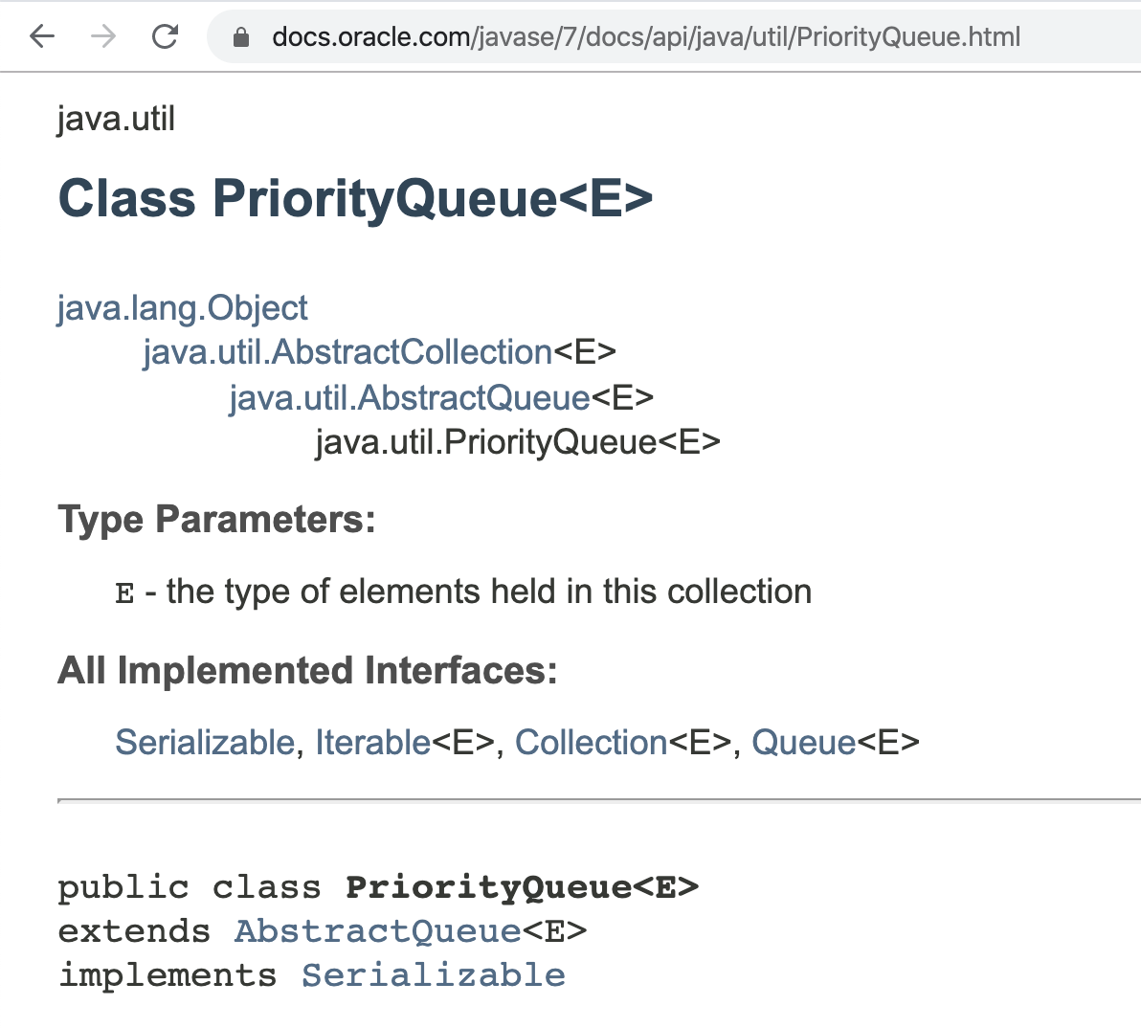
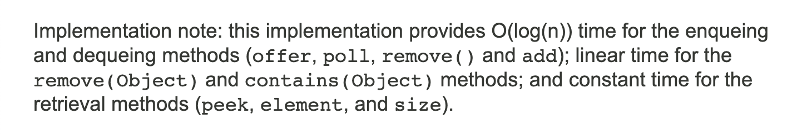

Slide 23

Code-Along
Write a function to reverse an integer array

Slide 24

Write a function to reverse an integer array
Write a function to reverse an integer array in place

Slide 25
Write a function to reverse an integer array in place
5
3
12
10
1
18
7
7
18
1
10
12
3
Input:
5
output:
0
1
2
3
4
5
6
0
1
2
3
4
5
6
“in place” means “without using additional memory space”

Slide 26
Coding Procedures
First, write Tests
Test should fail
Then, implement Feature
Test should pass
And then, refactor
Test should still Pass

Slide 27

How do you test your reverse function?
reverse twice, it’ll be back to the input
[1, 3, 5] → [5, 3, 1] → [1, 3, 5]

Slide 28

Homework 1 Review
Java programming basics
Write your own tests
Get comfortable with the grading process

Slide 29
Homework 1 Review
2 problems to solve
Binary Search
Bubble Sort

Slide 30
Binary Search
Target: 14
1
3
5
7
9
10
12
12
14
14
18

Slide 31
Homework 1 Review
2 problems to solve
Binary Search
Bubble Sort

Slide 32
Bubble Sort
9
1
8
7
3
1
9
8
7
3
Round 1
1
8
9
7
3
1
8
7
9
3
1
8
7
3
9

Slide 33
Bubble Sort
1
8
7
3
9
1
8
7
3
9
Round 2
1
7
8
3
9
1
7
3
8
9

Slide 34
Bubble Sort
1
7
3
8
9
Round 3
1
7
3
8
9
1
3
7
8
9

Slide 35
Bubble Sort
1
3
7
8
9
Round 4
1
3
7
8
9

Slide 36
Bubble Sort
1
3
7
8
9
Round 5
1
3
7
8
9

Slide 37
Homework 1 Submission
Instructor repo, main branch
Fork (”meaning copy”)
your repo, main branch
Pull Request
This url is what you submit
your repo, Work branch
more commits

Slide 38
Next Lecture
Code-Along
Object Oriented Programming

